Slide 1
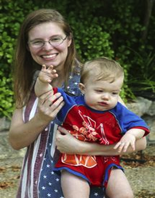
Interventions for Children with Combined Vision and Hearing Loss
Pennsylvania Part C Provider Training
March 29, 2016
Presenters:
Megan Cote, National Center on Deaf-Blindness
Carol Darrah, Georgia Sensory Assistance Project
Emma Nelson, Vermont Sensory Access Project

Slide 2


National Center on Deaf-Blindness
As a national technical assistance center funded by the federal Department of Education, NCDB works to improve the quality of life for children who are deaf-blind and their families.
Megan is the Initiative Lead for Early Identification/ Referral and Family Engagement.

Slide 3

Georgia Sensory Assistance Project
The Georgia Sensory Assistance Project (GSAP) is funded through the US Department of Education, Office of Special Education Programs. GSAP provides technical assistance to families, educators, and related service providers of children and youth with deaf-blindness- ages birth through 21 years.
Carol Darrah is the GSAP Early Childhood Coordinator, focusing her efforts on early identification and referral, supporting families and early intervention providers, and assisting with transition from early intervention to school services.

Slide 4

Vermont Sensory Access Project: Vermont's Deafblind Project
As a state technical assistance project funded by the federal Department of Education, the Vermont Sensory Access Project (VSAP) works to improve the quality of life for children who are deaf-blind and their families.
Emma is Project Coordinator and has been focusing on Early Identification and Referral of Vermont children birth - three with combined vision and hearing loss.

Slide 5
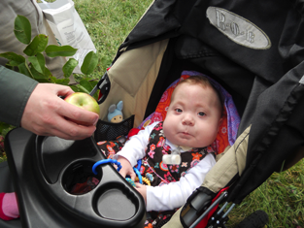
What we want to accomplish:
Increase your understanding of:
What is deaf-blindness?
Implications for early intervention
National and state resources related to Deaf-Blindness

Slide 6

Definition of Deaf-Blindness
When we hear the term deaf-blind, we often imagine a person who is unable to hear or see anything; however, this is typically not the case.
“Deaf-blind” describes any combined hearing and vision loss that significantly limits children’s ability to get information from people and objects around them.

Slide 7
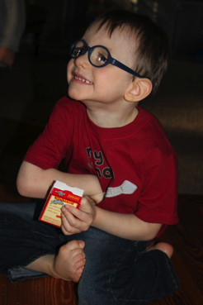
Etiologies of Deaf-Blindness
There are a wide variety of causes of deaf-blindness
Children might be at risk for having combined vision and hearing losses, due to:
hereditary syndrome or disorder
pre-natal condition
post-natal condition
family history
head injury
direct trauma to ear / eye
prematurity

Slide 8
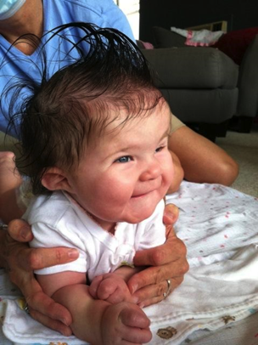
Diversity in Deaf-Blindness
Some individuals have other disabilities in addition to vision and hearing loss.
Approximately 90% of children with deaf-blindness have one or more additional disabilities or health problems; 75% have two or more; 50% have three or more.
For children with complex needs, hearing and vision loss may not yet be recognized or addressed.

Slide 9

National Child Count
Each state conducts a census of children and youth who are deaf-blind (birth through age 21).
Information from all states is compiled and reported in the annual National Child Count of Children and Youth who are Deaf-Blind.

Slide 10

Population of Children
With Deaf-Blindness: Birth-21
Black circle: All children age Birth-21 in the U.S. (~87,877,000)
Grey circle: Children age Birth-21 receiving special education (6,874,909)
Yellow circle: Children age Birth-21 with deaf-blindness (9,384)

Slide 11

Population of Children
With Deaf-Blindness: 0-2
Red circle: All children age 0-2 in the U.S. (~11,277,000)
Pink circle: Children age 0-21 receiving special education (339,071)
White circle: Children age 0-2 with deaf-blindness (561)

Slide 12
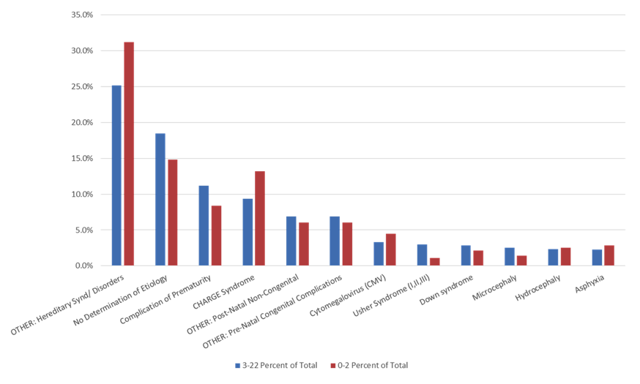
National Prevalence: Birth-21
The chart shows percent of total. Etiologies shown in order of prevalence are: OTHER: Hereditary Synd/Disorders; No determination of Etiology; Complication of Prematurity; CHARGE Syndrome; OTHER: Post-Natal Non-Congenital; OTHER: Pre-Natal Congenital Complications; Cytomegalovirus (CMV); Usher Syndrome (I, II, III); Down Syndrome; Microcephaly; Hydrocephaly; Asphyxia.

Slide 13
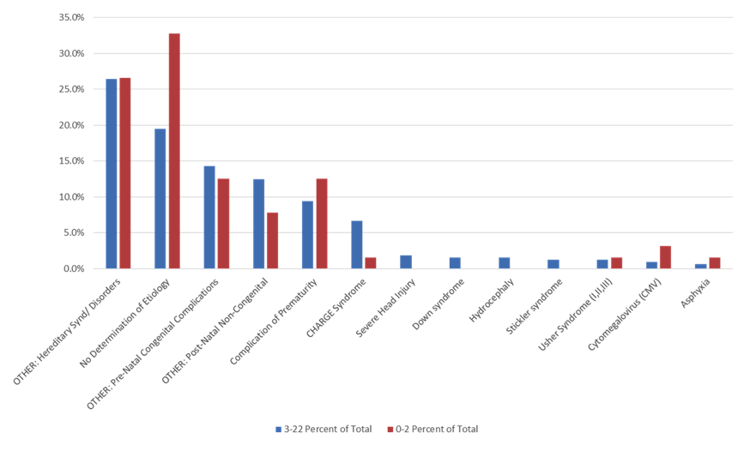
Pennsylvania Prevalence: Birth-21
The chart shows percent of total. Etiologies shown in order of prevalence are: OTHER: Hereditary Synd/Disorders; No determination of Etiology; OTHER: Pre-Natal Congenital Complications; OTHER: Post-Natal Non-Congenital; Complication of Prematurity; CHARGE Syndrome; Severe Head Injury; Down Syndrome; Hydrocephaly; Stickler Syndrome; Usher Syndrome (I, II, III); Cytomegalovirus (CMV); Asphyxia.

Slide 14
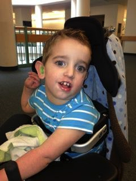
Early Identification & Referral
It is recommended that children with one diagnosed sensory impairment (hearing or vision) be evaluated in the other area.
Referrals to medical and educational services should be made in a timely manner.
DO NOT “Wait and See”

Slide 15
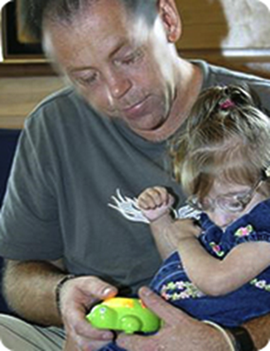
Population of Children with
Deaf-Blindness
Deaf-blindness is rare!
Providers often have limited experience working with children who are deaf-blind.
Families are often responsible for educating service providers about deaf-blindness and specifically about their child.

Slide 16
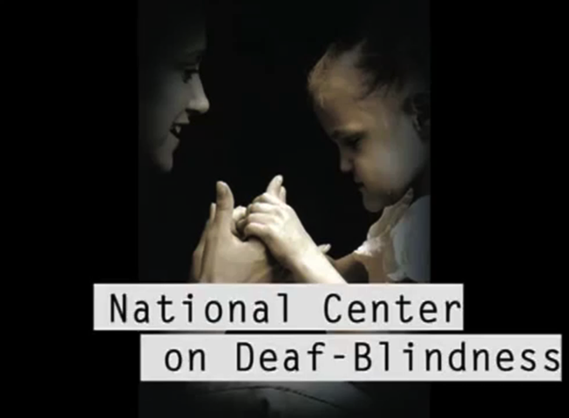
Video about deaf-Blindness
National Center on Deaf-Blindness (NCDB): Deaf-Blindness Perspectives
Notes:
https://www.youtube.com/watch?v=4pFf9-id3V4

Slide 17
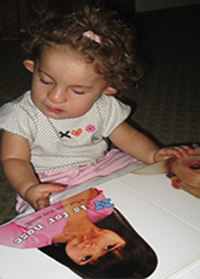
Deaf-Blindness is a disability…
about INFORMATION GATHERING
which LIMITS ACCESS
which is EXPONENTIALLY
MORE than a hearing
loss plus a vision loss

Slide 18
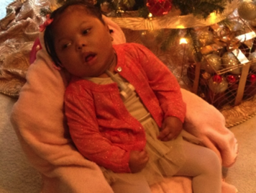
The Seven Senses
Distance Senses
Vision
Hearing
Smell
Impact Senses
Touch
Taste
Vestibular (relation of body in space)
Proprioception (relation of body to itself)

Slide 19
Typical Learners
Did you know…
  95% of all learning is through distance senses
  80% of learning is through vision
  90% of learning is incidental

Slide 20
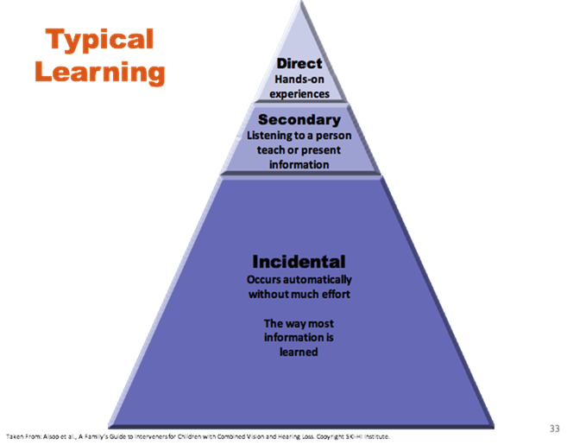
Typical Learning
Triangle showing three parts. Top small portion shows Direct: hands-on experiences; middle small portion shows Secondary: Listening to a person teaching or present information; and lower two-thirds of triangle portion indicates Incidental: Occurs automatically without much effort. The way most information is learned.

Slide 21
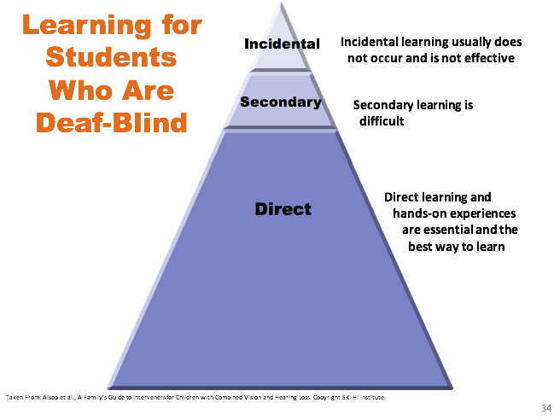
Learning for Students Who Are Deaf-Blind
Triangle showing three parts. Small top portion is Incidental: Incidental learning usually does not occur and is not effective; Small middle portion is Secondary: Secondary learning is difficult; lower portion is two-thirds of triangle. It is Direct: Direct learning and hands-on experiences are essential and the best way to learn.

Slide 22
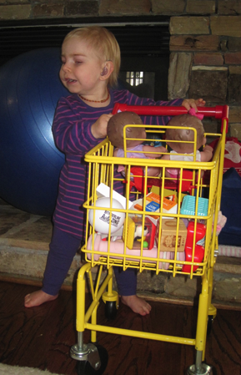
Learning Needs of
Children with Deaf-Blindness
•Hands-on experiences
•Active movement and exploration of their environment
•Predictable, accessible schedules, consistency
•Use of residual hearing and sight
•High expectations
•Trusting relationships
•Communication, communication, communication!

Slide 23
Considerations for Learners with Deaf-Blindness
•Anticipation – what is going to happen to me, where am I going, who is with me
•Motivation- isolation and withdrawal, lack of exploration, interest in environment and people
•Communication - language development, turn taking, interaction, socialization
•Confirmation – this is how things work, when I do this, this thing happens, this thing does this action, this facial expression or tone of voice means this

Slide 24
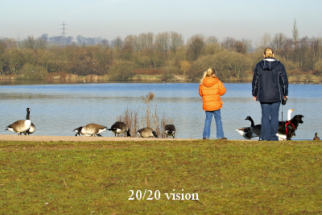
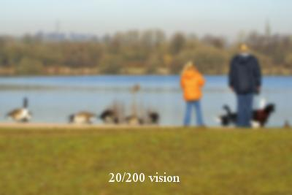
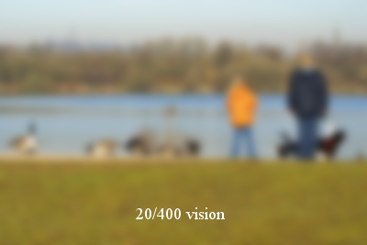

Simulation 20/20 to 20/400
Simulation image scene at lake edge with mother and daughter with dog. There are geese along the bank. The simulation shows vision changing from 20/20 to 20/200 to 20/400
Notes:
Simulation Activity. From 20/20 to 20/400 using the animation in slideshow.

Slide 25

Questions for Section One

Slide 26
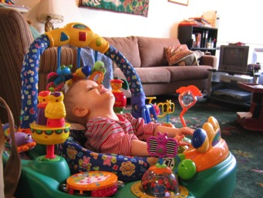
Implications for Intervention
Environmental Considerations
Touch
Communication
Social/Emotional
Concept Development

Slide 27
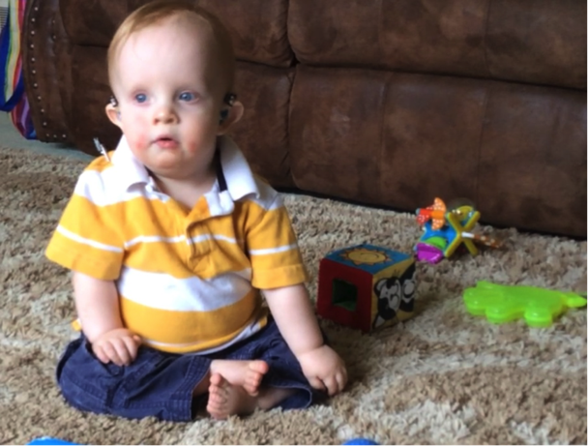
Environmental Considerations

Slide 28
What are Environmental Considerations?
Visual (Contrast, Size, Lighting)
Auditory (Background noise, Acoustics)
Other Sensory Input- Tactile, Olfactory, Taste, Proprioceptive, Vestibular
Physical space- is the arrangement meeting the needs of the child?
Maximize the child’s use of residual vision and/or hearing

Slide 29
Resources for
Environmental Considerations
  Environmental Consideration Checklist by Dr. Mary Morse
  Perkins Webcasts: Adapting Environments for Individuals with Vision Loss by Darrick Wright
  10 Issues to Always Consider When Intervening for Students with Deafblindness by David Wiley
Notes:
http://tech.aph.org/cvi/wp-content/uploads/2015/02/Morse_EnvironmentalChecklist.pdf
http://www.perkinselearning.org/videos/webcast/adapting-environments-individuals-vision-loss
http://www.tsbvi.edu/resources/3114-10-issues-to-always-consider-when-intervening-for-students-with-deafblindness

Slide 30
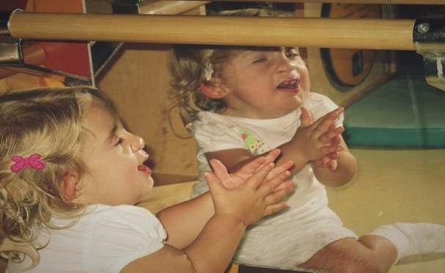
Touch

Slide 31
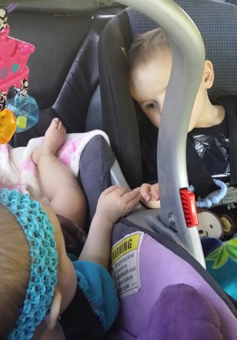
Interactions with Touch
All human beings require tactile input
Research shows that positive “touches” are correlated with good physical and mental health
Touch assists learners with deaf-blindness to come out into the world and engage with a partner

Slide 32
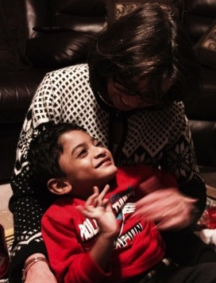
Assessment of the
Tactile Environment
How / when does the learner have physical contact with others? How does the learner respond to these physical interactions?
How / when does the learner have an opportunity to touch, explore, handle, and use materials?

Slide 33
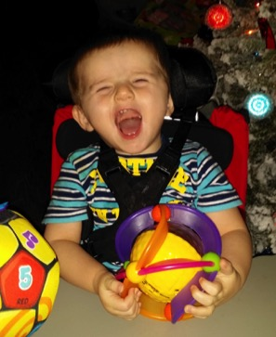
Assessment of the
Tactile Environment (Cont.)
How is the environment arranged / organized to encourage tactile exploration and movement?
What adaptations might better facilitate the learner’s exploration, handling, and manipulation of objects?
(Chen & Downing, 2006, pp. 55 & 57)

Slide 34
What is a Touch Cue?
A TOUCH CUE consists of
tactile contact,
made in a consistent manner
directly on the learner’s body,
to communicate with her.

Slide 35
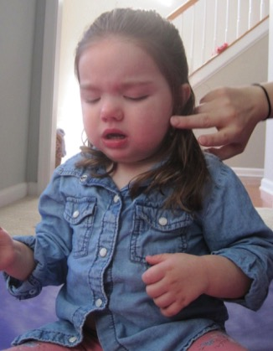
Why use Touch Cues?
The PURPOSE of a touch cue is to communicate who is there and what’s going to happen.
May reduce a learner’s startle or challenging behaviors, by helping her anticipate what is going to occur.

Slide 36
Examples of Touch Cues
Tapping the child’s bottom (in supine)- “I’m going to lift your hips” (for diaper)
Gently pulling up on the child’s upper arms - “Get ready to stand up.”
Touching the child’s left elbow - “This is the way I say ‘HI,’ so you know who I am.”
Touching the child’s ear- “Time to put your hearing aids on.”
Notes:
http://www.cadbs.org/news/a03-touch-cues/

Slide 37
Resources for Touch Cues
See Project SALUTE: Successful Adaptations for Learning to Use Touch Effectively
California Deafblind Services Fact Sheet
Notes:
Pause at this point and ask them to go look at it???
Mark will add Lyn Ayers article
http://www.projectsalute.net/Learned/Learnedhtml/TouchCue.html
http://www.cadbs.org/news/a03-touch-cues/

Slide 38
The Hands of a
Learner with Deaf-Blindness
Hands can be used as…
EYES
EARS
TOOLS
VOICE
STRESS RELIEVERS

Slide 39
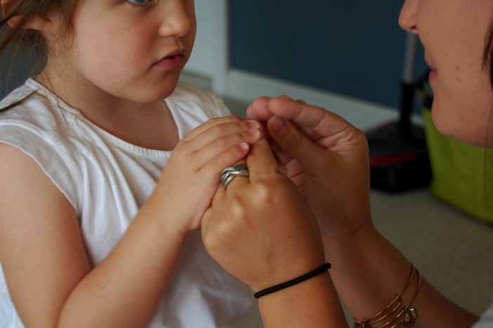
Hand-under-Hand

Slide 40
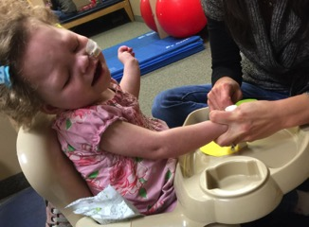
What is Hand-under-Hand?
Hand-over-Hand
is often used as a teaching strategy, but it is passive, aversive, and does not respect the learner’s preferences.
Hand-under-Hand
is a strategy where the learner’s hands are gently guided from underneath, which allows the child to explore and participate as they choose.

Slide 41
Considerations for using
Hand-under-Hand Strategies
Guide the learner’s hands from underneath--offer her an “invitation” to join an interaction
Invite the learner to “watch” while the partner uses something with her hands
Honor her request, if a learner pushes the partner away
Hand-under-Hand encourages children to explore and learn while being respectful of their hands.

Slide 42
Why use Hand-under-Hand?
  Would you ever put your fingers into the eyes of a child, who has vision, to direct her attention to something?
The use of hand-under-hand strategies frees the learner’s hands so they may be used, at her discretion, for: safety, self-stimulation, exploration, communication, protection, functional skill performance.

Slide 43
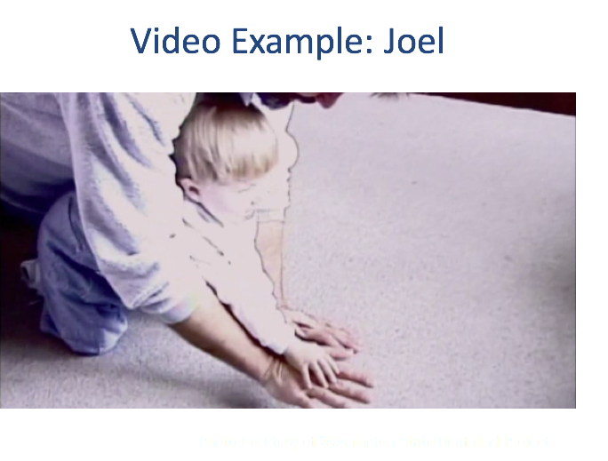
Hand-under-Hand Video
Hand-Under-Hand Techniques
(http://www.wsdsonline.org/hand-under-hand/)
Notes:
http://www.wsdsonline.org/hand-under-hand/

Slide 44
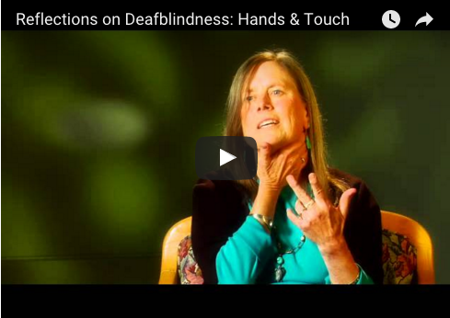
Hand-under-Hand Resource
http://www.perkinselearning.org/videos/webcast/reflections-deafblindness-hands-touch
Notes:
http://www.perkinselearning.org/videos/webcast/reflections-deafblindness-hands-touch

Slide 45
Questions Section Two

Slide 46
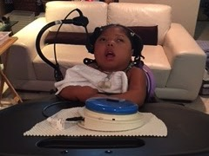
Communication

Slide 47
Strategies for Consistent Interaction
When approaching the learner, always let her know you are there
Identify yourself to the learner every time you are with her, even if she has partial sight
Always let the learner know what is going to happen next
  Use TOUCH CUES
  Use OBJECT CUES
Notes:
Make sure to talk about the need for the routines to be consistent across providers

Slide 48
Strategies for Consistent Interaction (Cont.)
Whenever possible, allow the learner the opportunity to make choices in an activity
Utilize a tactile cue to let the learner know when you are available for interaction
Find a way to always let the learner know when an activity is finished
Always let the learner know when you are leaving

Slide 49
Communication: Multi-Modal
Multi-modal communication
  Objects
  Coactive signs
  Signals and cues
  Calendar systems
Wait time
Watch entire child
Matt with Jarvis at the Drum Store
Notes:
http://library.tsbvi.edu/Play/83

Slide 50
Missed Communication
Children who are deafblind miss opportunities to:
  Observe the communication of others
  Participate in communication themselves
Communication attempts may be missed or misunderstood

Slide 51
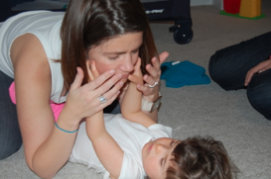
Communication: Gaining Information
Children who are deafblind:
  Will use multiple modes of communication, either simultaneously or at different times for different purposes
  Will often use all senses to gain information about their environment

Slide 52
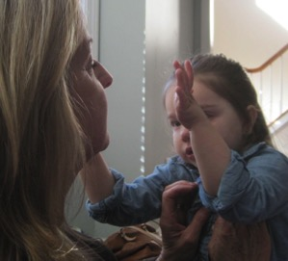
Shared Modes of Communication
The mode of communication you use must be accessible to the child
Model communication using shared modes
Provide for incidental learning through access: allow the child to observe conversations in his/her shared mode

Slide 53
Communication Resources: Communication Matrix
Communication Matrix Developed by Charity Rowland
The Communication Matrix is designed to assess the expressive communication for learners who use very early stages of communication and progress slowly. Pre-intentional through beginning language are addressed in relation to refusing, obtaining, social interactions and seeking information.
Notes:
www.communicationmatrix.org

Slide 54
Communication Resources: Communication Mapping
The Communication Map by Kathleen Stremel The Communication Map is designed to assess expressive and receptive communicative intents and forms. The visual profile provides information for short and long term programming.
Kansas Deaf-Blind Project Learning Modules: Communication Mapping Distance Mentorship Training Modules

Slide 55
Additional Communication Resources
Watkins, S. & Clark, T.C. (1991). A coactive sign system for children who are dual-sensory impaired. American Annuals of the Deaf, 136, (4), 321-324.
Project Salute
  Project Salute Home Page
  Project Salute Coactive Signing
Notes:
http://www.projectsalute.net/
http://www.projectsalute.net/Learned/Learnedhtml/Coactive.html

Slide 56
Questions Section Three

Slide 57
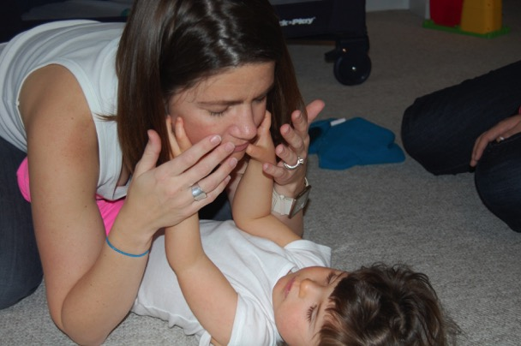
Social Emotional

Slide 58
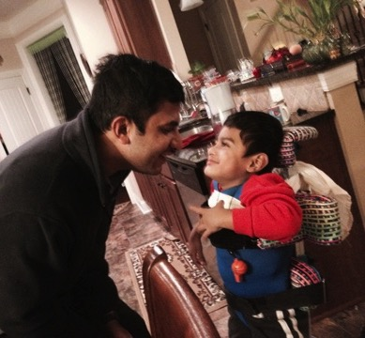
Social Emotional: Key Factors
Encouraging Relationships and Bonding
Fostering Trust
Stress
Intervener Support

Slide 59
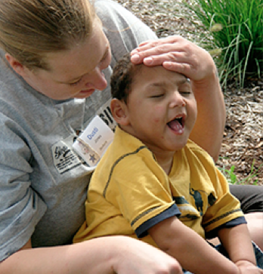
Building Rapport
Approach child from side
First point of contact: shoulder or leg, not hands
Use voice, personal identifier, or touch to identify yourself
Wait for acknowledgement, allow child to turn, reach, connect
Photo: Washington Sensory Disabilities Services

Slide 60
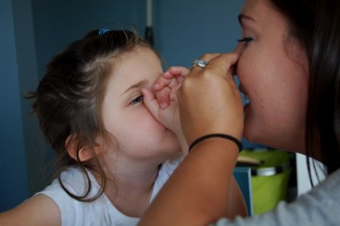
Building Rapport (Cont.)
Make yourself available, move slowly
Provide wait time
Observe child for communication attempts:
  movements
  muscle tension
  change in posture
  eye gaze
  vocalizations
  gestures
Respond through turn taking

Slide 61
Active Learning
The child builds relationships and feels secure
Begins to explore and reach out
Active Learning
  Emphasizes items or activities with sound, tactile elements, movement
  The Learner is the active one
  Everyone can learn
LilliWorks Active Learning Foundation
Notes:
http://www.lilliworks.org/

Slide 62
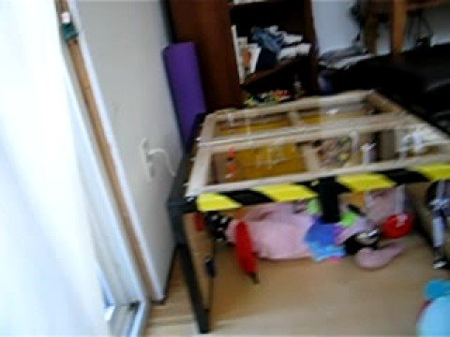
Video Example: Active Learning
Zoe in the "Little Room"
Notes:
https://www.youtube.com/watch?v=X7_S4dfN_-U

Slide 63
Resources for Social Emotional
Supporting Parent Access to Resources, Knowledge, Linkages and Education
  SPARKLE
Interveners and Children Who Are Deafblind
  Intervener
Active Learning
LilliWorks
Notes:
http://www.sparkle.usu.edu/
http://www.intervener.org/
www.lilliworks.org

Slide 64
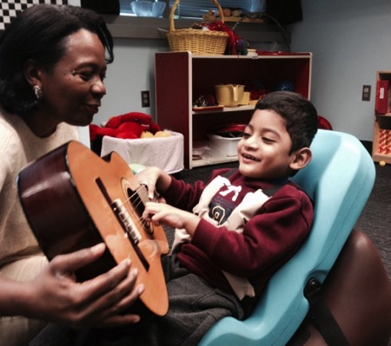
Concept Development

Slide 65
Concept Development:
Key Factors
Concepts vs. Skill
Concepts
  Concrete concepts (i.e., chair)
  Semi Concrete concepts (i.e., jumping)
  Abstract Concepts (i.e., nervousness)
Concepts
  People and Relationships
  Objects
  Places
  Routines, Actions, and Activities

Slide 66
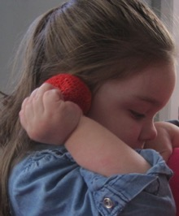
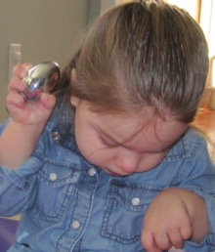
Concept Development: Objects
Objects exist
Objects have permanence
Objects differ
Objects have names or labels
Objects have characteristics
Objects have functions or use
Notes:
Emma will replace this.

Slide 67
Concept Development:
Obtaining Information
Essential information is missed and incidental learning is greatly limited
All individuals have an “ongoing struggle to obtain information.”
Alsop, L., Blaha, R., & Kloos, E. (2000). Intervener in early intervention and educational settings for children and youth with deafblindness. Monmouth, OR: Western Oregon University, Teaching Research, National Technical Assistance Consortium for Children and Young Adults Who are Deaf-Blind.

Slide 68
Concept Development: Needs
Children need:
  Hands on experiences
  Shared experiences
  Thoughtful presentation of experiences that “enable them to develop a gradually expanding view of the world.”
  Information, materials, and experiences presented in multimodal formats
Miles, B. & McLetchie, B. (2008). Developing Concepts with Children Who Are Deaf-Blind. Monmouth, OR: The National Consortium on Deaf-Blindness.

Slide 69
Resources for Concept Development
  Perkins. Strategies for Early Cognitive Skills/Concept Development: Perkins School for the Blind eLearning
  Cause and Effect, Object Functions, Object Permanence, Taking Turns
  SPARKLE: SPARKLE Concept Development
  What a Concept by Jim Durkel at the Texas School for the Blind TSBVI What a Concept!
Notes:
http://www.perkinselearning.org/
http://www.sparkle.usu.edu/Topics/concept_development/index.asp
https://www.tsbvi.edu/seehear/spring00/concept.htm

Slide 70
Resources for Concept
Development (Cont.)
  Strategies and Content Modifications for the Child with Deaf-Blindness by Kate Moss at the Texas School for the Blind Developing Concepts With Children Who Are Deaf-Blind
  Developing Concepts with Children Who Are Deaf-Blind by Barbara Miles, M. Ed. and Barbara McLetchie, Ph. D.
Notes:
https://www.tsbvi.edu/seehear/archive/strategies.html
http://documents.nationaldb.org/products/concepts.pdf

Slide 71
Activity
Daniel Makes a Smoothie Video
http://www.wsdsonline.org/hand-under-hand/ (2nd video)

Slide 72
Questions Section Four

Slide 73
If I suspect that I have an infant, toddler or preschool-age child with Deaf-Blindness, what do I do?

Slide 74
If the child is already enrolled in PA’s Early Intervention Program
Identification
The IFSP/IEP team, including the Service Coordinator, Parent and team members should determine if the child meets the criteria for deaf-blindness.
Include in
DB Census
If the child meets the criteria for deaf-blindness, the Infant Toddler Coordinator or Preschool Supervisor should add them to the Deaf Blind Census
Refer to Technical Assistance Support
Family Support
Staff Support & Training
Contact Anne Gaspich at agaspich@pattan.net
Contact Mary Anketell at manketell@pattan.net or your local EITA consultant
3 Columns: Column 1: Identification: The IFSP/IEP team, including the Service Coordinator, Parent and team members should determine if the child meets the criteria for deaf-blindness; Column 2: Include in DB Census: If the child meets the criteria for deaf-blindness, the infant Toddler Coordinator or Preschool Supervisor should add them to the DeafBlind Census; Column 3: Refer to Technical Assistance Support: Family Support - contact Anne Gaspich at agaspich@patten.net, Staff Support & Training - Contact Mary Anketell at manketell@patten.net or your local EITA consultant

Slide 75
If the child is NOT YET enrolled in PA’s Early Intervention Program
By Phone
CONNECT Helpline at 1-800-692-7288
Online
www.compass.state.pa.us

Slide 76
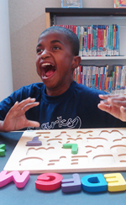
Here come the resources…..

Slide 77

National Center on Deaf-Blindness (NCDB)
Address:
The Research Institute
Western Oregon University
345 Monmouth Ave, OR 97361
Phone: (503) 838.8754
Fax: (503) 838.8150
Email: support@nationaldb.org
Website: nationaldb.org

Slide 78

National Family Association for Deaf-Blind (NFADB)
Address:
141 Middle Neck Road
Sands Point, NY 11050
Phone: 800-255-0411
Email: NFADB@aol.com
Website: NFADB.org

Slide 79

Helen Keller National Center
Address:
141 Middle Neck Road
Sands Point, NY 11050
Phone: (516) 944-8900
Email: hkncinfo@hknc.org
Website: www.hknc.org

Slide 80
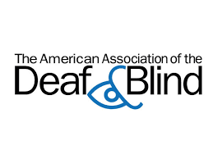
The American Association of the Deaf & Blind
Address:
PO Box 8064
Silver Spring, MD 20907-8064
Phone: 301-563-9064 Videophone
Email: aadb-info@aadb.org
Website: www.aadb.org

Slide 81

CHARGE Syndrome Foundation
Address:
318 Half Day Rd #305
Buffalo Grove, IL 60089
Phone: (516) 684-4720
Toll Free: (800) 442-7604
Fax: 1-888-317-4735
Email: info@chargesyndrome.org
Website: www.chargesyndrome.org

Slide 82

Family Leadership Project
Family Leadership Project Website
The purpose of FamiliesLead.org is to bring a network of people and organizations together to share ideas, resources and support for leadership training for parents and other family members of individuals with disabilities.
Notes:
http://familieslead.org/

Slide 83
On-line Module Resources
East Carolina University deaf-blind modules
Modules Addressing Special Education and Teacher Education
Select Students with Deafblindness (left column): Modules: Introduction, Developmental Impact, Educational Implications
East Carolina University Mini Modules Teacher Support Program for Students with Deafblindness
Notes:
http://mast.ecu.edu/picker.php
http://www.ecu.edu/cs-educ/ci/sped/dbproject/Mini-Modules.cfm

Slide 84
Training Distance Mentorship
12 FREE on-line self-paced modules:
1. Interactions with Touch
2. Interactions with Objects
3. Calendar Systems
4. Communication Mapping
5. Development of Communicative Intentionality
6.Gestural Development
7. Hand under hand strategies
8. Piaget and the symbolization continuum
9. Utilizing Routines
10. Introduction to Vision Loss
11. Introduction to Hearing Loss
12. Introduction to Learners with Deaf-Blindness
To receive a user name and password email Jon Harding: jharding@kssdb.org

Slide 85
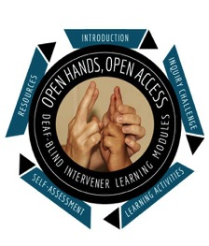
OHOA Deaf-Blind Intervener
Learning Modules
A national resource designed to increase awareness, knowledge, and skills related to the process of intervention for students who are deaf-blind. Developed by the National Center on Deaf-Blindness.
For a list of partners and contributors visit:
nationaldb.org/ohoamoodle/contributors.html
For more information:
Go to moodle.nationaldb.org or
Contact support@nationaldb.org

Slide 86
Additional Resources
ALL children CAN read...let us show you how!
Home Talk
Tips for Home and School from Nevada Deaf Blind Project
Washington Sensory Disabilities Services: Deaf Blind
Washington Sensory Disabilities Services Home Page
Perkins School for the Blind: Webcasts
Perkins School for the Blind Home Page Look for Teaching Resources
Notes:
http://literacy.nationaldb.org/
http://documents.nationaldb.org//HomeTalk.pdf
http://www.unr.edu/ndsip/
http://www.wsdsonline.org/video-topics/
http://www.wsdsonline.org/
http://www.perkinselearning.org/videos
http://www.perkins.org/

Slide 87
National Center on Deaf-Blindness
Initiative Groups:
  1) Intervener Services and Qualified Personnel
  2) Early Identification/ Referral
  3) Technology Solutions
  4) Family Engagement
  5) National Child Count
  6) Literacy
  7) Transition
Please make a profile and join a group!

Slide 88
***Remember***
Learners who have deaf-blindness are an incredibly diverse group
Deaf-blindness is a disability about information gathering!
Incidental learning is challenging.
Purposeful and meaningful activities foster development
Determining a shared mode of communication is key
A learner with deaf-blindness is NOT a “deaf” child who cannot see or a “blind” child who cannot hear. Deaf-blindness is unique and complex disability.

