Slide 1

Creating change
Transforming instruction for students with deafblindness
December 1, 2016
Notes:
Good morning and afternoon everyone!
I would like to thank the National Center on Deafblindness and the Council for Exceptional Children for this opportunity to speak with all of you today. It is no easy thing when you endeavor to bring change to any organization. It is my sincere hope, though, that you will find something in the telling of our story that you can take back with you to improve your program, your school, or your district.

Slide 2
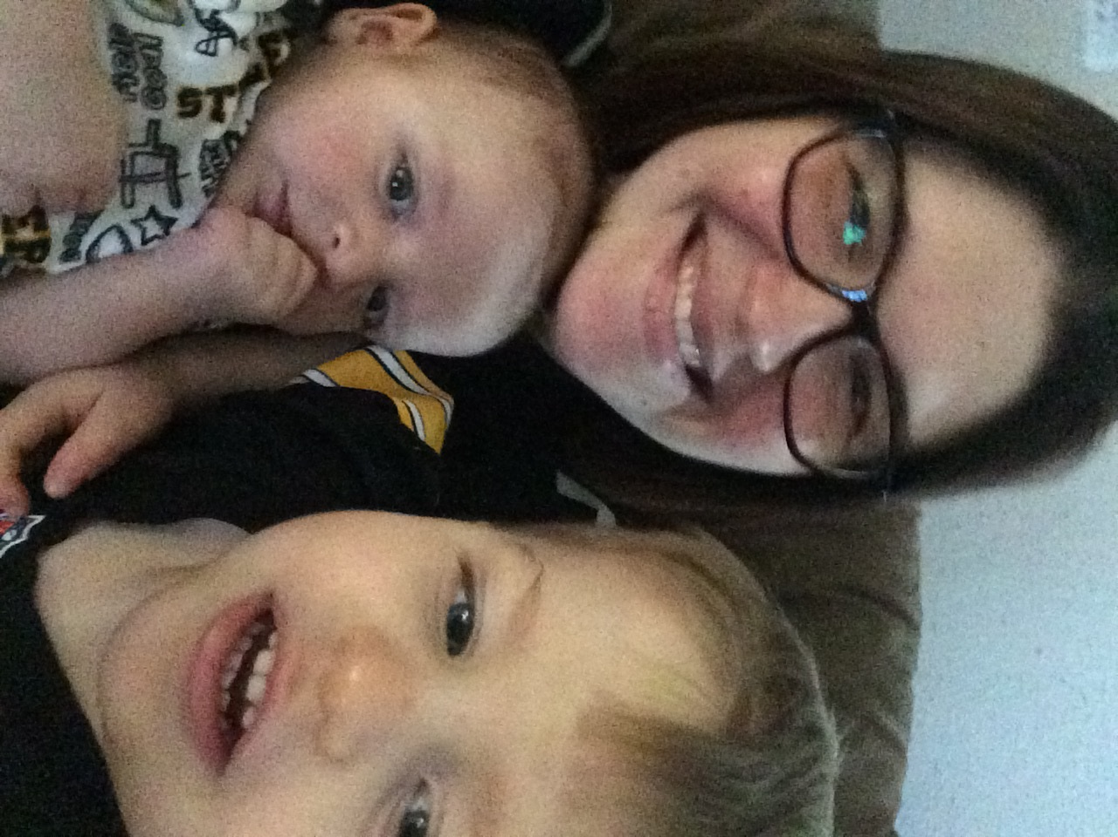
Please let me introduce myself
Marina McCormick, M.Ed.
Region 4 Regional Day School Program for the Deaf (RDSPD) Coordinator
16 years of experience in education
Wife and mother of 2 sons and a Boston Terrier
Big Pittsburgh Steeler fan
Notes:
Who am I?
My name is Marina McCormick, and I currently work as the Region 4 Regional Day School Program for the Deaf Coordinator in Houston, Texas. I have 16 years of experience in education. I started my career as a teacher of the deaf in a middle school self-contained classroom. After three years, I became an itinerant teacher, traveling across four to five school districts. I had the opportunity to serve several students with deafblindness during my teaching career, but I can honestly say that unfortunately, it was not until I became an administrator that it occurred to me that more could and should be done for this unique population of students.
After being an itinerant teacher for eight years, I accepted my first administrative position as a special education lead. I coordinated four programs: services for students with auditory and visual impairments, occupational and physical therapy, and preschool programs for children with disabilities. It was strenuous but rewarding work, and it was during this time that I met a student with deafblindness who would change the course of my life forever. He challenged my thinking on what I thought I knew about servicing students who were deaf with additional disabilities. He taught me the meaning of commitment, of perserverance. He taught me about advocacy and about teamwork.
He is quite simply why I am here with all of you today, and in a very real sense, he is at the center of the change effort of our program in regards to students with deafblindness. I once read the following quote: “Lighthouses don’t go running all over an island looking for boats to save; they just stand there shining.” He bettered me as an educator and as an administrator without saying a word, but by simply shining.

Slide 3
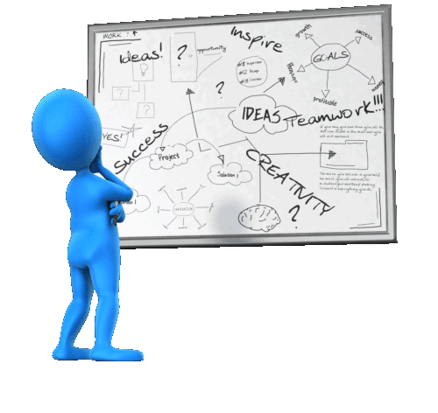
Learning intentions &
Success criteria
Notes:
So how am I going to help you shine today?
Learning intentions
By the end of our time together, you will -
Understand the importance of viewing change as a process
Understand the importance of communicating your vision to the teams you work with and support
Success criteria
I will know that I have been successful in working with you if you can -
List the 8 steps of John Kotter’s model for successful organizational change.
Write a draft of your “why” statement.

Slide 4
WHAT IS rdspd
What is a Regional Day School
Program for the Deaf (RDSPD)?
Notes:
So before we go on, it’s important for you to know what a Regional Day School Program for the Deaf or RDSPD is.

Slide 5

A UNIQUE PROGRAMMING OPTION
Notes:
An RDSPD is a unique programming option within the state of Texas in which school districts and charter schools enter into shared service arrangements (i.e., a legally-binding contract) to consolidate special education services that benefit students who are deaf and hard of hearing. RDSPDs were established in an attempt to provide services more effectively and efficiently due to the low-incidence nature of hearing loss (TEA, 2013)
Also, as I progress through the presentation, you may at times hear me say the abbreviation, “AI”. This is a term used only in Texas. In Texas, students with hearing loss can be eligible for special education as a student with an auditory impairment or AI.

Slide 6
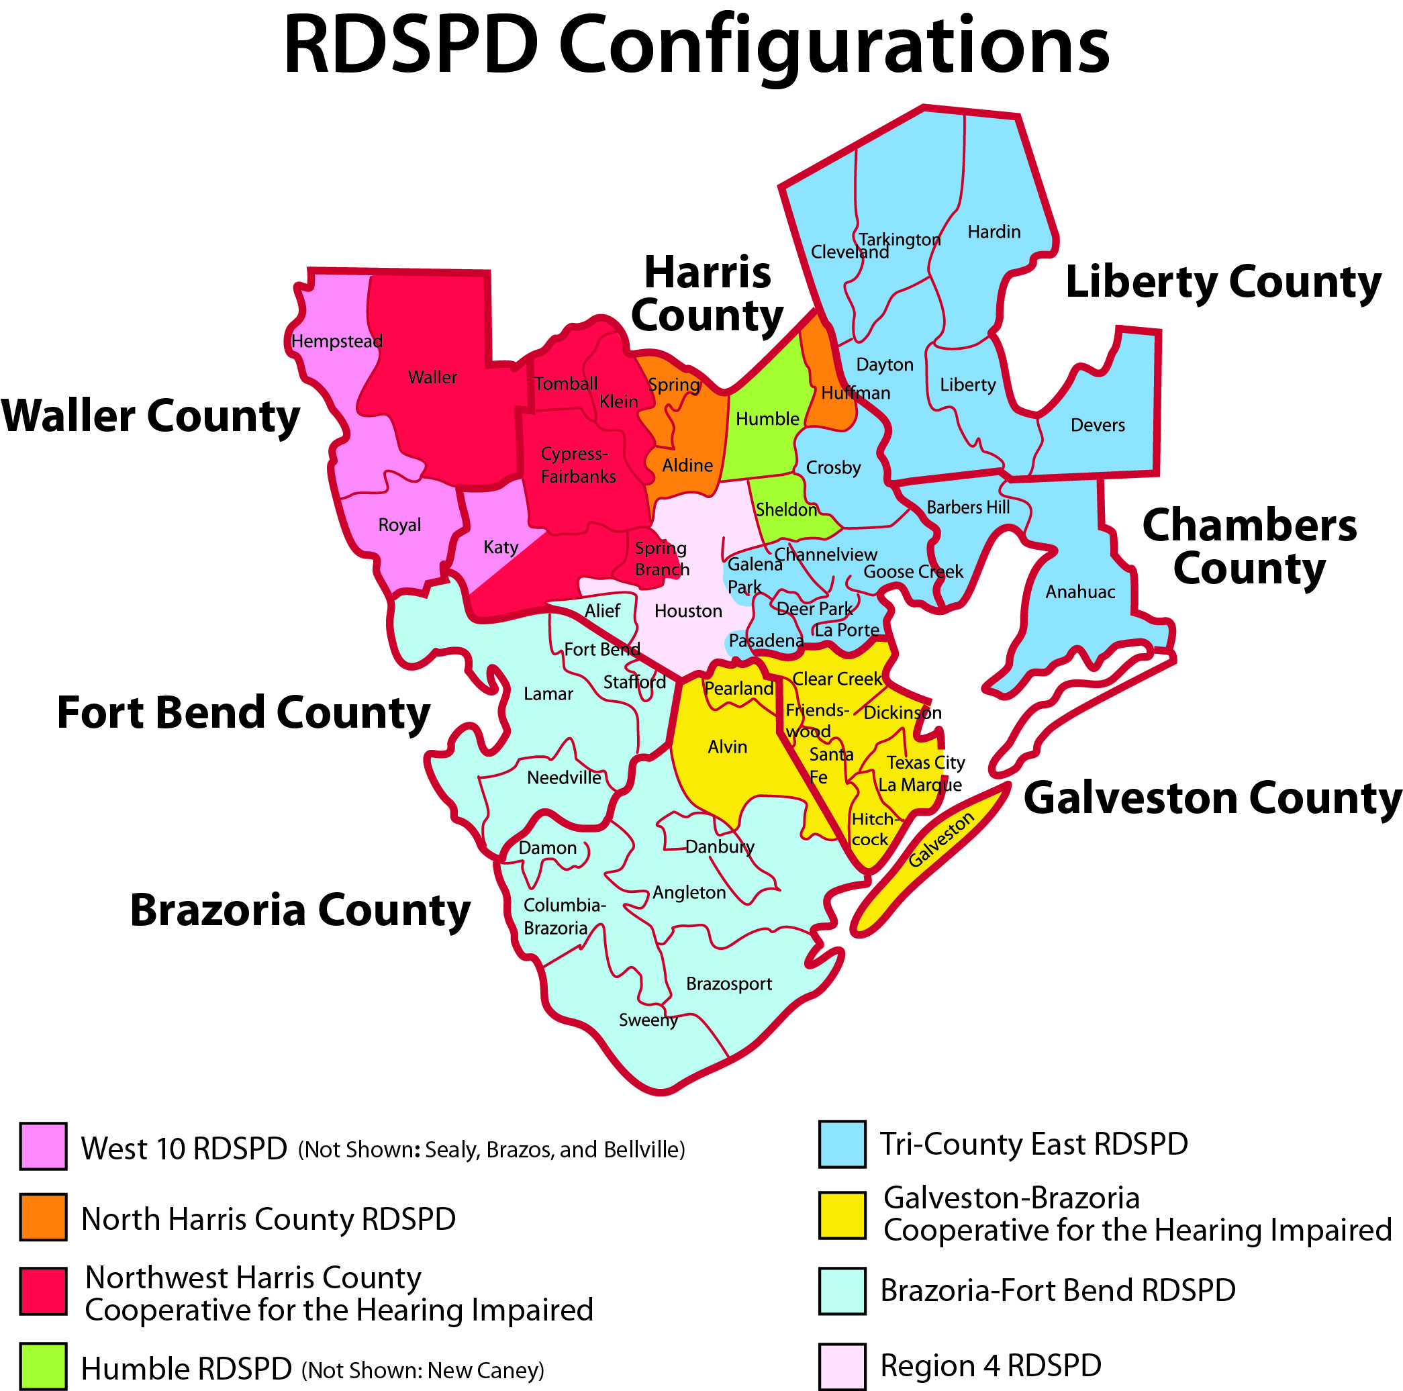
Area served by region 4
Notes:
This is a map of the area served by Region 4 Education Service Center. Within this area, there are 8 Regional Day School Programs for the Deaf. The green arrow points to the Region 4 RDSPD.

Slide 7
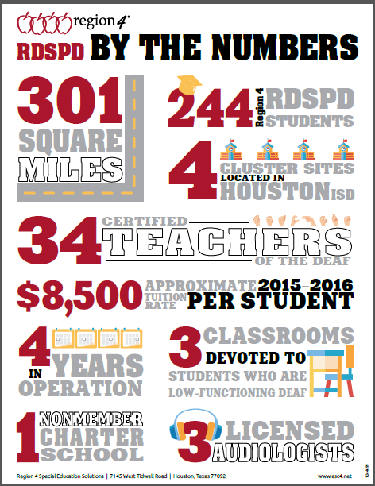
Region 4 by the numbers
Notes:
Last school year, in its fourth year of operation, the Region 4 RDSPD served 244 students with hearing loss in the heart of Houston, Texas. The program covered 301 square miles, supported one local charter school, and had 4 cluster site locations. Cluster sites are campuses that have staff and resources allocated to them to support students who are deaf and hard of hearing. In the program, we have 34 teachers of the deaf and 3 audiologists, along with many other ancillary staff members including evaluation specialists, social workers, and speech and language pathologists. We are fortunate in our program to have 3 classrooms – elementary, middle, and high school levels – devoted to students who are low-functioning deaf.

Slide 8
At the end of the 2016 school year:
40% increase in the number of students with deafblindness receiving services from our program
Two skilled one-to-one aides for two academic students with deafblindness
Asked by the Texas Deafblind Project to pilot the Informal Functional Hearing Evaluation (IFHE)
Asked to speak at the 2017 Texas Deafblind Symposium, a statewide conference for professionals and families
Parent praise and encouragement
Notes:
During the 2014-2015 school year, our program had identified that it needed a better approach to serving our students with deafblindness. The leadership developed a plan for change in the spring of 2015 and by the end of 2016 had some pretty spectacular short-term wins. As you can see, these wins came from our community, our campuses and the district, as well as from the state.

Slide 9

Mic drop moment
Notes:
So this is how we felt, right? Mic drop! Boom! We are awesome!
As they say at the end of every amazing rock concert, “Peace! We’re out!”
But not quite. How did this all happen?

Slide 10

It’s magic
Notes:
Do people ever wonder how you do what you do? Do you ever feel like saying, “It’s magic!” when in reality, you know it’s not. That happened to our program. Other districts and other RDSPDs in the area would reach out to us individually and ask, “How do you do that?”

Slide 11

Pyramid of success
Notes:
Do kids just magically succeed? Hardly. We know that there are many people working tirelessly to ensure that our students fulfill their potential and end up on the top of the pyramid of success.

Slide 12
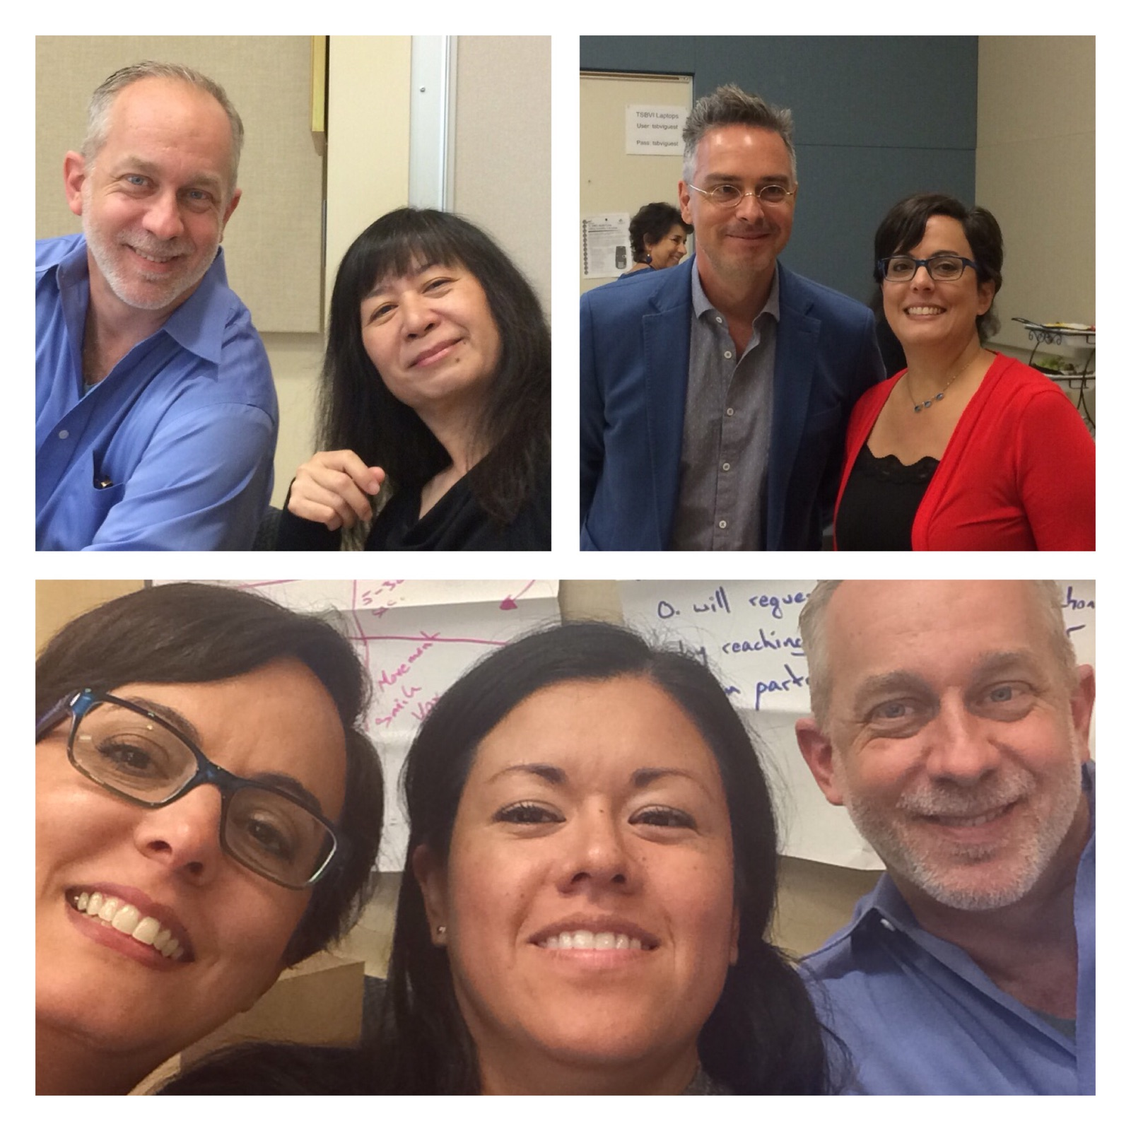
Collaborators
Notes:
The short-term wins I just shared with you didn’t just happen by themselves. Behind the scenes, many days and weeks of collaboration occurred between key individuals to make this instructional approach a reality. In the top left, we have our certified orientation and mobility specialist and our Region 4 ESC Educational Specialist for Visual Impairments. In the top right, we have our regional contact from the Texas School for the Blind and Visually Impaired and our program’s itinerant teacher for students with deafblindness. In the bottom frame is our Region 4 RDSPD Sensory Team. The woman in the middle is our teacher of the deaf.
Our program’s journey all started with an article written by a proverbial Wizard of Oz, so without further ado, I’d like to introduce you to him now.

Slide 13
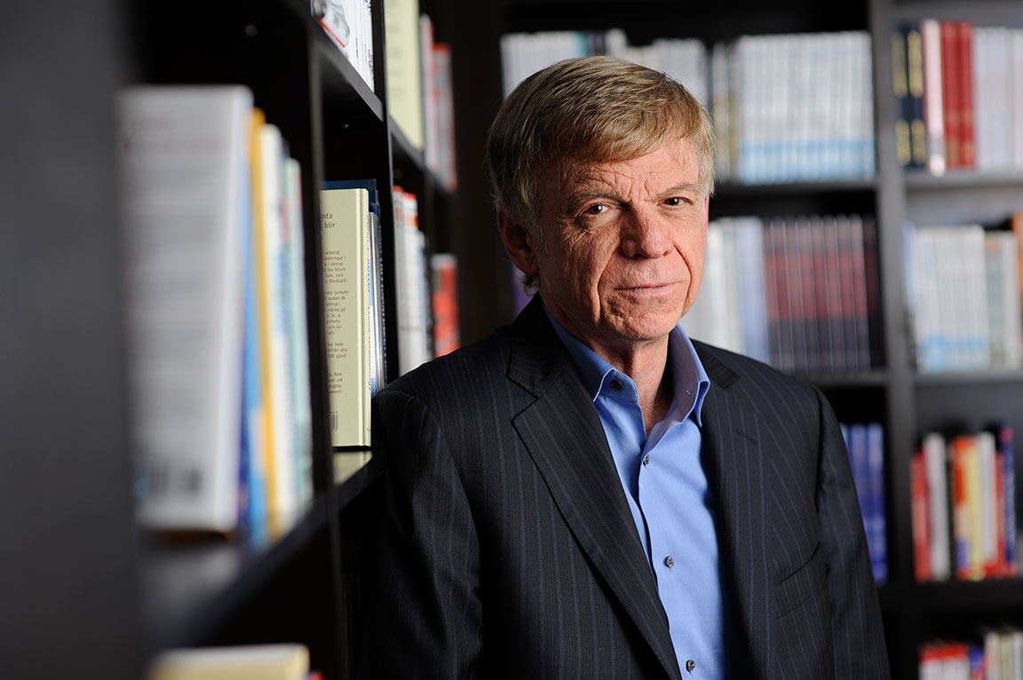
John Kotter, Ph.D.
We WILL pay attention to
that man behind the curtain!
Konosuke Matsushita Professor of Leadership, Emeritus, at the Harvard Business School
New York Times best-selling author
Founder of Kotter International
Well-known authority on leadership and change
Photo credit: http://inspiration.samhoud.com/2014/10/interview-john-kotter/
Notes:
Let me introduce to you the man behind our program’s curtain. This is Dr. John Kotter. In 1995, Dr. Kotter shared with the world his 8-step process for change in the Harvard Business Review with a little article titled “Leading Change: Why Transformation Efforts Fail”. Since then, through both his work at Harvard and Kotter International, he has assisted countless leaders and businesses to transform themselves for the better. I had the good fortune to learn of Dr. Kotter’s process while earning my certificate for principalship. Though it was written with business management in mind, its applications extend to other sectors, including education.
So what is Dr. Kotter’s 8-step model for change?

Slide 14
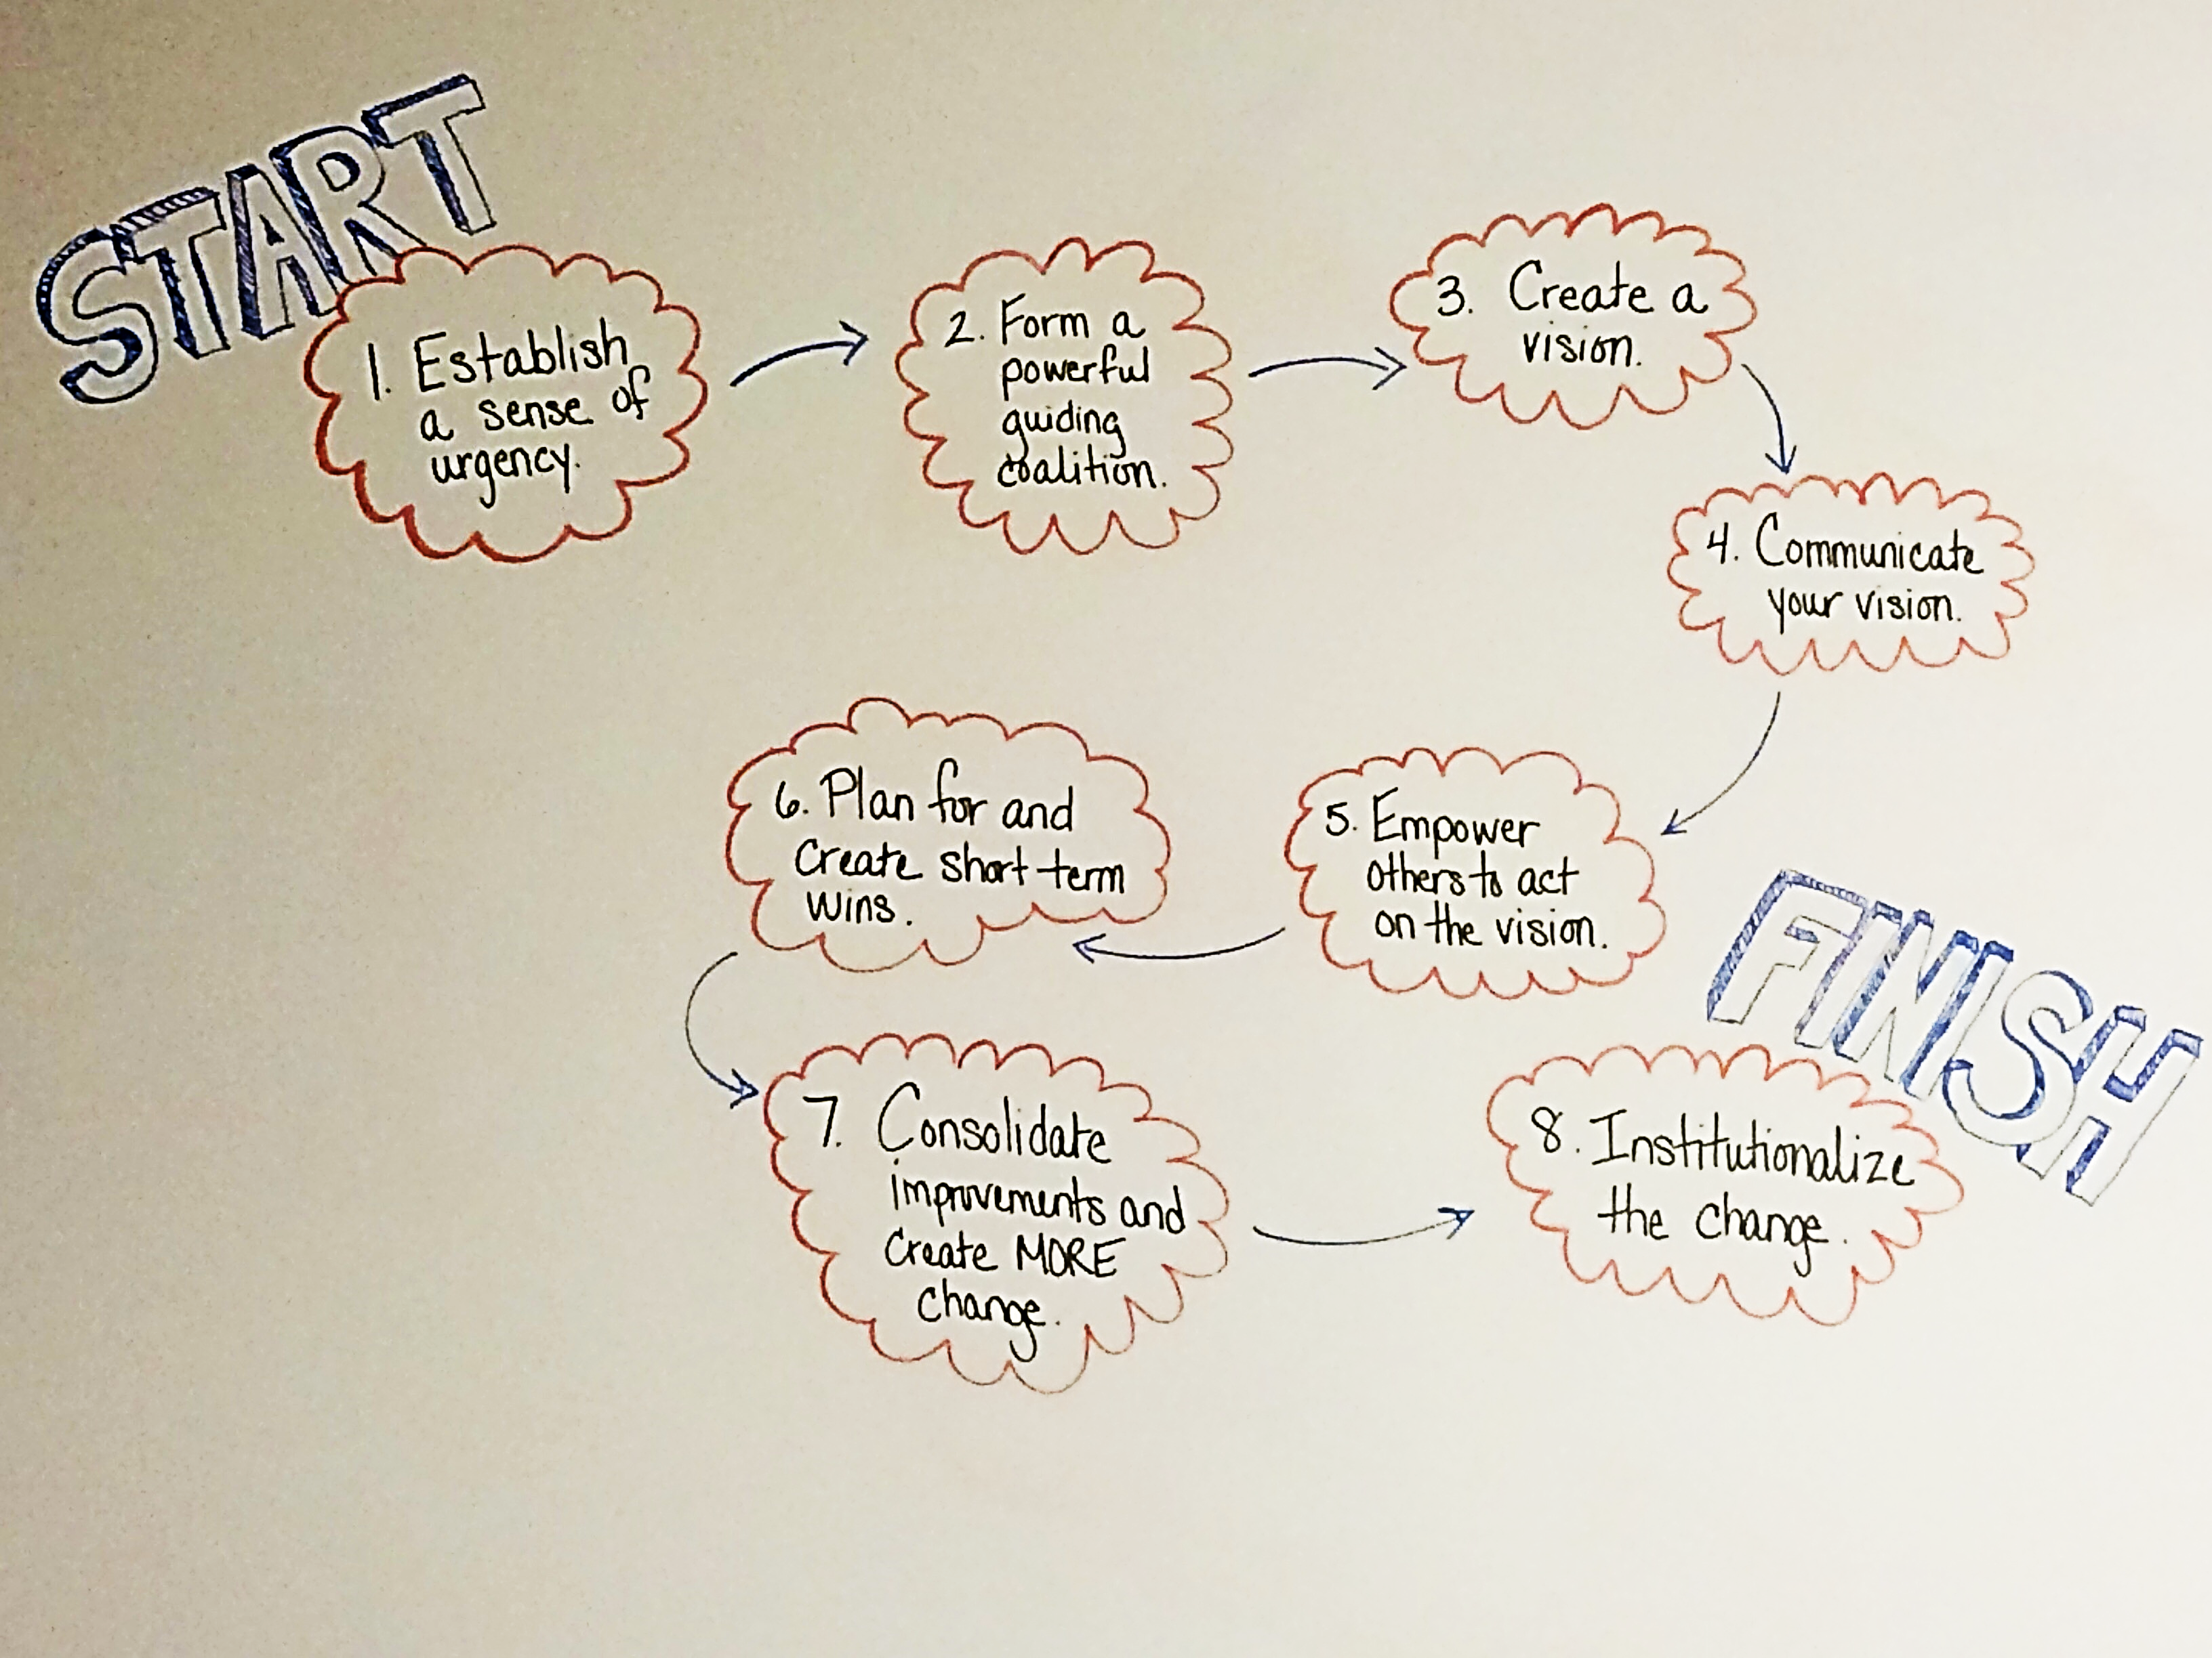
Dr. Kotter’s Process for change
Notes:
Now I do not claim to be an expert on Dr. Kotter’s 8-step process for change, but I did rely heavily on it as it guided my thinking when approaching our concern for our students with deafblindness. Doesn’t it seem so simple when you look at it? It seems to say, “If you do all of these 8 steps, you will change your life, your school, your program, your business, your fill-in-the-blank, and you will have success!”
That would be very assuming of us if we were to think of it as a simple process. Perhaps the most simple part of the process is writing the steps on your white board.
For the remainder of our time together, I will be sharing with you how we used Dr. Kotter’s 8-step process to drive change within our program to better serve students with deafblindness.

Slide 15
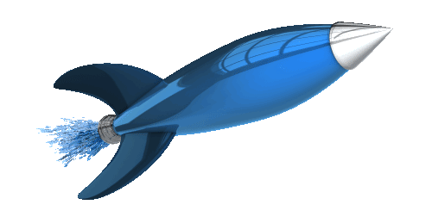
1. Creating a sense of urgency
Houston, we have a problem.
Notes:
So, like all great stories, we’ll start at the beginning. How did we develop a sense of urgency within our program and our member district?

Slide 16
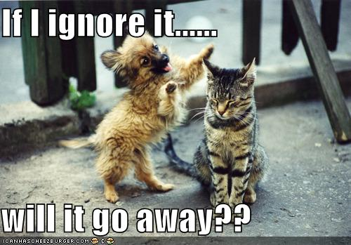
Ignoring problems
Photo credit: http://www.getrealphilippines.com/blog/2013/12/living-in-bubbles-pop-goes-the-philippines/
Notes:
Sometimes, people like to ignore problems.

Slide 17


Admiring problems
Notes:
Sometimes, people like to admire problems.

Slide 18

Different sense of urgency
Photo credit: http://www.hlntv.com/video/2013/08/21/breaking-bad-911
Notes:
Sometimes, people have a sense of urgency about a problem that’s very different from the one you’ve identified.

Slide 19

How we Began to create a sense of urgency
We started by gathering and analyzing our data.
Notes:
In the spring of 2015, the first thing we did was review our annual census data for students with deafblindness and compared it to what our IEPs were telling us.

Slide 20
Deafblind services provided by region 4 RDSPD
Notes:
The pie chart reveals that our member district had 22 students with deafblindness. During the 2014–2015 school year, the Region 4 RDSPD was directly serving only one of the 22 identified students. Having 22 students in one district was incredible considering that across the nation in 2014, there were a total of 9,384 students with deafblindness (The National Center on Deaf-Blindness, 2015). Why, though, was there only one student directly served by our program?

Slide 21

Loss adversion
Notes:
Sean Ryan, a partner at A.T. Kearney where he leads the Strategy, Marketing and Sales Practice for the Americas, says there are two very personal reasons why people resist change – loss aversion and conformity. Let’s talk about loss aversion first. Research shows that as individuals, we prefer avoiding losses over achieving equivalent gains. In the case of our program and how it had been supporting students with deafblindness, this was evident. Two years ago, the RDSPD staff had not questioned whether or not there was more that could be done to support students with deafblindness. There was a practice of the district’s teachers of the visually impaired taking the lead for students with deafblindness with teachers of the deaf acting in supporting roles. Often, teachers of the deaf or visually impaired had limited knowledge concerning programming and service options for this unique population. The preference for the known over the risk of the unknown had resulted in consultative rather than direct support for students.

Slide 22

conformity
Notes:
The second force, conformity, Ryan points out, is a bit more insidious. When we began analyzing our students’ IEPs, at various times, the question, “Why does this happen?” would arise, and time and time again, the answer would be, “That’s how it’s always been.” Conformity begins at the individual level, and if left unchecked, it is then compounded at the organizational level. Most often, organizations change from a reactive, rather, than a proactive state. We began our change process with a foot in both states, if you will.
It’s incredibly difficult to stand alone, especially when, as was our situation, you suspect something could be better, but you’re not sure how to go about making it so. I believe that people enter education to help children, and they make the best decisions they can with the knowledge that they have at the time. As Maya Angelou said, “Do the best you can until you know better. Then when you know better, do better.”
We were about to know a whole lot better. Within our data there was an inherent challenge: How could the Region 4 RDSPD provide high-quality instruction for this student population?

Slide 23

2. Form a powerful guiding coalition
I love it when a plan comes together!
Photo credit: http://www.themoviethemesong.com/the-a-team-tv-theme-song/
Notes:
According to Kotter, forming a powerful coalition is the next step in his 8-step process for change. You need your A-Team when you want to bring about change! If you involve the wrong people, you’ll only end up spinning your wheels.
What our program saw in practice, was that we had a four-person leadership team that was the initial coalition. This consisted of…

Slide 24
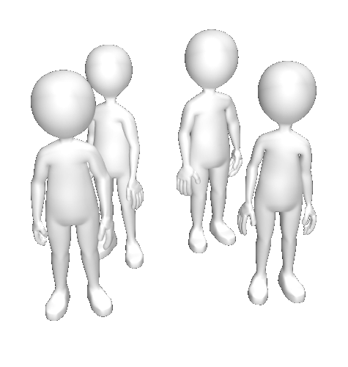
Team
Program Specialist for AI
Program Specialist for AI
Program Manager for AI
RDSPD Coordinator
Notes:
Our 2 program specialists operate in a similar fashion as instructional coaches for the RDSPD. The member district’s program manager oversees the day-to-day management of the RDSPD whereas I manage the overall efficacy of the program from the Region 4 Education Service Center. This was the initial group of people responsible for driving the change process, but over time, the coalition grew to include others depending on the task we needed to achieve as part of the change process. For example…

Slide 25
Approving the position
Approving the
Position
Program Manager & Senior Manager for AI Services
RDSPD Coordinator
RDSPD Management Board
Notes:
To approve the position of an itinerant teacher of the deafblind for our program, we needed…

Slide 26
Creating the position
Creating the
Position
RDSPD Coordinator and Region 4 Educational Specialists for VI
Program Manager & Senior Manager for AI Services
Human Resources Department
Notes:
To create the actual itinerant position, we needed…

Slide 27
Considerations for creating the position
CEC DVIDB Knowledge and Skills for Initial Special Educators Serving Students with Deafblindness
Possible state certification requirements
Commitment to ongoing professional development and technical assistance
Skills in collaboration and teaming
Notes:
When creating the job position and job description, we looked at these elements. We embedded information from the CEC DVIDB Knowledge and Skills. Since Texas currently does not have state certification for a teacher of the deafblind, it was recommended that the position be listed as having certification for students with hearing or vision loss with dual certification in these areas being preferable. We also knew the position would require intensive training so we made this clear in the position as well, indicating the position required professional development with the Texas School for the Blind and Visually Impaired Deafblind Outreach team. Finally, because this was to be an itinerant position, it was important to recognize that the person hired would need to have the ability to work with multiple teams and to collaborate well so this too became part of our description.

Slide 28
Region 4 rdspd sensory team
Students with deafblindness
Itinerant teacher for students with deafblindness
COMS
Teacher of the Deaf
Program Specialist for AI
Program Manager for AI
RDSPD Coordinator
Region 4 RDSPD
Sensory Team
Notes:
Once the position was posted and a suitable candidate was found, we created the coalition we lovingly called The Sensory Team. Our team design was based on what I had learned from attending the Intervener Team Model at the Texas School for the Blind and Visually Impaired with only some minor modifications.

Slide 29
The core team
Students with deafblindness
Itinerant teacher for students with deafblindness
COMS
Teacher of the Deaf
Notes:
In the Intervener Team Model, the idea of a core and an extended team for students with deafblindness is reviewed. This is our core team. Our itinerant teacher for students with deafblindness had certification as a teacher for the visually impaired. To complement her skills, we brought on a teacher of the deaf. Finally, because orientation and mobility skills allow students who are deafblind to synthesize residual visual, auditory, and other sensory information to interpret their environments, we knew we had to have a certified O&M specialist on our core team.
In the beginning, this team, as a whole, had very little working knowledge regarding instruction for students with deafblindness, but within one year, they became a powerhouse! It was all thanks to their commitment and dedication to children.

Slide 30
Admin core team
Students with deafblindness
Program Specialist for AI
Program Manager for AI
RDSPD Coordinator
Notes:
On the administrator side, these three positions are also part of the core team. Due to the size of our member district, it was important that one of our program specialists and that the program manager be linked to the Sensory Team for day-to-day concerns. My involvement with the team was and remains intensive in overseeing the team’s professional development, coaching them in the application of skills learned.
So in looking at Kotter’s model, our core coalition was the program’s four-person leadership team as I shared earlier, but different coalitions were formed based on the action needed that would drive the change effort.

Slide 31

3. Create a vision
You are not allowed to say,
“I believe that children are our future.”
Trademarked!
Notes:
While step 3 in Kotter’s process is creating a vision, I must admit that we created our vision earlier in the process. Once we decided we wanted to change how we were serving students with deafblindness, we went about creating our vision. Having a vision is critical to the change process. The vision is where you want people to go, but having people buy into the destination can be tricky if you aren’t able to communicate your vision clearly.

Slide 32


How we created our vision
Photo credit: http://www.speakers.ca/speakers/simon-sinek/
Notes:
Perhaps some of you recognize this man. His name is Simon Sinek, and he’s a famous optimist and leadership consultant. In his book, “Start with Why”, he says that the inspired leaders and the inspired organizations – regardless of their size, regardless of their industry – all think, act, and communicate from the inside out. He goes on to say that people don’t buy what you do; they buy why you do it. Inspired, highly effective organizations are able to communicate ,in order, the why, how, and what regarding what they do, and it is this type of communication that drives others to action.
What does this look like, though, in education?

Slide 33

Yes prep public schools
Photo credit: http://www.yesprep.org/our-model
Notes:
Perhaps you may have heard of Yes Prep Public Schools.
Yes Prep is an open-enrollment public charter school system that focuses on serving students, grades 6-12, in the Houston area. It is most well-known for its mission of increasing the number of students from socioeconomically challenged communities who graduate from college. Every year, a lottery is held, and every year, hundreds of students sit on the waiting list, hoping to receive the call that they will now attend Yes Prep.
Yes Prep follows The Golden Circle of communicating from the inside-out.

Slide 34
Yes prep philosophy
Why
How
What
Notes:
Yes Prep tells you the why first: We exist to send 100% of our students to college.
Then they tell you the how: Our schools are small and integrated with a specialized curriculum. We offer rigorous assessments. We host extended school days and school years. We offer numerous enrichment opportunities. We have personalized college counseling for all of our students.
Then after all that, they mention the what: We just so happen to teach kids. Want to send your children to our school? Well, of course we do!
Our core coalition had to discover what our why was. There are plenty of ways you can do this, but identifying your vision, your “why” is a topic that we won’t be able to devote much time to for our time together today. However, if I could leave with you with one piece of advice to take with you as you begin defining your vision, it would be this:

Slide 35
Creating a vision
Put a dream in front of people,
not a mission. Missions are finite.
Dreams are forever.
Dreams are personal.
Kevin Carroll, Author & Speaker
Notes:
This perfectly sums it up for me. One time, I was managing a team of special education teachers in a school district, and we spent a day crafting our vision. I can recall vividly what happened when I put the following sentence on our brainstorm board: “Our students are visitors.” This statement caused a lot of discussion. One teacher remarked, “Some of our students never make it out of special education. Why would we have that be a part of our vision?” to which I replied, “Because that dream never changes regardless of whether or not the student remains in special education for his entire educational career.”
Dreams are forever, like the quote says. What is your dream for your students?
For our program, after much discussion among the leadership, our why became one clear, concise sentence.

Slide 36
Vision statement
For all students, the Region 4 RDSPD
believes in equal access
to educational opportunities.
Notes:
Notice, though, that this doesn’t tell you how or what we will do, but it is something that every staff member and every person involved with our program could get behind and believe in. Notice too that it is a dream. It is something to strive for in every day, every moment.

Slide 37
Communicating our why
Why
How
What
For all students, the Region 4 RDSPD believes in equal access to educational opportunities.
We provide equal access through a team approach, focusing on collaboration and continuous communication. For students with deafblindness in particular, our program would provide a district-level team of decidedly knowledgable and well-trained individuals who could work with various outside agencies, multidisciplinary teams, families, and students to assess and plan for high-quality instruction.
We educate students with deafblindness.
Notes:
This is how we chose to communicate our vision, our “why”. When we began communicating from the inside-out, as Sinek calls it, buy-in increased. Even though this step is third in Kotter’s 8-step process, In our experience, our core coalition actually created our vision after analyzing our baseline data. In our opinion, we needed to be able to communicate a plan to various stakeholders, and having our “why” solidified helped with those critical conversations.

Slide 38

4. Communicating your vision
Extra! Extra! Read all about it!
Notes:
Again, developing and communication your vision are topics that really could be explored on their own across a two-day training. I will only be skimming the surface with you regarding how to communicate your vision, sharing with you how our program decided to do this step.

Slide 39

Communicating vision every hour
Notes:
Communicating your vision is something that needs to be done every hour of the day in every possible way. It’s important that you get creative in how you communicate your vision. Kotter says in his article that your why should be simple enough that it could be explained in less than 5 minutes.

Slide 40
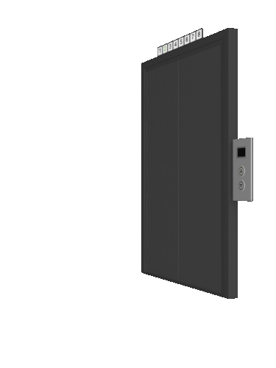
Elevator pitch
Notes:
In my experience, though, one sentence is really what you shoot for when creating your vision. It’s an approach referred to as an elevator pitch. An elevator pitch is a short, concise summary of a process, a product, or an organization and its promise of value.
Not a lot of time on the elevator so you have to get right to the point! If you had to explain your vision, your why, to someone you met on the elevator, what would you say?

Slide 41



Communicate your why a lot
Notes:
The reason the elevator pitch is helpful, in my opinion, is because you will be communicating your why a lot. You want people to be able to articulate the why so they can internalize the why. If you spend five minutes on describing the why to someone, the chances are good that they will have an idea of what the vision is about, but it is possible the person will walk away with a different understanding than you intended.
One sentence a person can repeat over and over, time and time again, in good times and in bad, when barriers appear and when explanations are needed, is powerful.

Slide 42

How to communicate your vision
Use all existing channels
Words and deeds
Consistency
Notes:
For us, we focused a lot of our communication on weekly meetings with the Sensory Team so that we could regularly revisit the vision, the “why”. In phone and e-mail conversations, I regularly cited our why, making the connection between the work and the purpose. In critical conversations as the team worked through the year and applied their learning, the why was shared. This year, we have moved our communication forward by having a program logo designed and encouraging staff to purchase t-shirts. We are also going to look into redesigning our webpage so that our why is apparent.
I would also add that it’s important to be consistent. If your actions do not match your words, individuals will not buy-in to your why nor will they support your change efforts. Again, it’s important to identify a why you can fully support as you move forward.
People will endeavor towards difficult goals if they know and believe the work is purposeful. Our work is undoubtedly challenging! To this end, you can never, in my opinion, say your why enough.

Slide 43

5. Empower Others to act on the vision
Use the force, Luke!
Notes:
Just like the Rebel Alliance communicated its vision of a free universe and empowered its small band of TIE Fighters to resist the Empire, so too do you need to empower others to act on your vision, your “why”.
When we created our Sensory Team, we knew there would be some logistical changes in how we did business, but we couldn’t have anticipated all of the tweaks we would need to make. Our staff throughout our program were incredibly helpful with this as they asked questions and shared concerns.

Slide 44

obstacles
You won’t be able to see all of the obstacles waiting for you.
Notes:
An obvious obstacle we were able to predict was IEP meeting participation, including required attendance, documentation on the schedule of services page, and required signatures. We also knew that our sensory team would need to have time to collaborate with one another so weekly meetings were established from the beginning.

Slide 45

Tackling barriers
But you can tackle them one at a time.
Notes:
Not so obvious barriers we discovered along the way were -
how to address identification of students with deafblindness at their initial evaluations,
how to free up our teacher of the deafblind’s time so she could collaborate with different assessment teams
how to use a data-driven process for determining the need for a skilled one-to-one aide or intervener
How to ensure that other itinerant teachers for the deaf or visually impaired within the district adhered to the same recommendations, approaches, and/or philosophies
These are barriers we are continuing to work on as we move into Year 2.

Slide 46

6. Plan for and create short-term wins
When you’re on a long journey, it helps if you can celebrate along the way.
Notes:
Imagine if someone said to you, “We are going on a trip to India tomorrow. We will not be taking a flight. We will get there by car and boat!” You would be initially excited about all of the things you would get to see and experience, right? But then, as the journey progressed, it might become difficult to maintain that excitement, especially if say, you get a flat tire or your cell phone breaks with all the photos you’re taking.
That’s why it would be important to celebrate all of the wonderful things happening around you while you traveled to India. And as you might expect, some of those small things that are happening to you along the way might be considered more amazing than the Taj Mahal.

Slide 47

Give team something concrete to shoot for
Notes:
As a change agent, it’s not enough to hope that your team will accomplish your vision, your “why”. You have to give the team something concrete to shoot for, but it can’t be something that is so difficult that the team abandons the whole idea.

Slide 48

Key components
Notes:
From the leadership perspective, we knew we wanted to increase the number of students with deafblindness being directly served by our program. I encouraged this by setting up the following explicit opportunities:
At the beginning of the 2015-2016 school year, the Sensory Team reviewed programming for five candidates as part of choosing their focus student for the Texas Teacher of the Deafblind Pilot. By facilitating such a review, the team discovered on their own that students with deafblindness received consultative rather than direct services for both auditory and visual needs.
I utilized cognitive coaching strategies to encourage team members to reach their own conclusions when faced with student concerns. For example, when our teacher of the deaf asked how much service time would be needed for one of our students, I asked her, “Given what the student’s goals and objectives are, how much time do you think you would need to help her make one year’s progress?” Unless it is an administrative issue, the team knows that I don’t tend to immediately answer many of their questions.
I recognized that members of our Sensory Team did not know exactly what instructional services they could offer to students who are deafblind. We focused on providing intensive professional development for the team that explicitly showed them what teachers of the visually impaired or teachers of the deaf or COMS could do to support students with deafblindness’ learning.

Slide 49

Celebrate success
Notes:
And every student that was added became a celebration for us. That was a wonderful short-term win! But there were more!

Slide 50
At the end of the 2016 school year:
40% increase in the number of students with deafblindness receiving services from our program
Two skilled one-to-one aides for two academic students with deafblindness
Asked by the Texas Deafblind Project to pilot the Informal Functional Hearing Evaluation (IFHE)
Asked to speak at the 2017 Texas Deafblind Symposium, a statewide conference for professionals and families
Parent praise and encouragement
Notes:
Kotter says in his article that short-term wins are scored within 12-24 months of the change effort. Remember these points from the beginning? Believe it or not, these are all short-term wins. They were all completed within 12 months of when we started on our journey.

Slide 51

7. Consolidate improvements and produce more change
Times change, [and] we need to change as well.
Notes:
So let’s go cross-continental now. When South Africa renounced Apartheid and freed Nelson Mandela, these changes did not automatically unite their nation. Though they were steps in the right direction, more change was needed to help the nation begin the healing process of years of racial hostility and division. Nelson Mandela knew this, and when he was elected president, he decided that he would consolidate these improvements by focusing on the most unlikely of vehicles in his country: The South African rugby team – the South African Springboks.

Slide 52
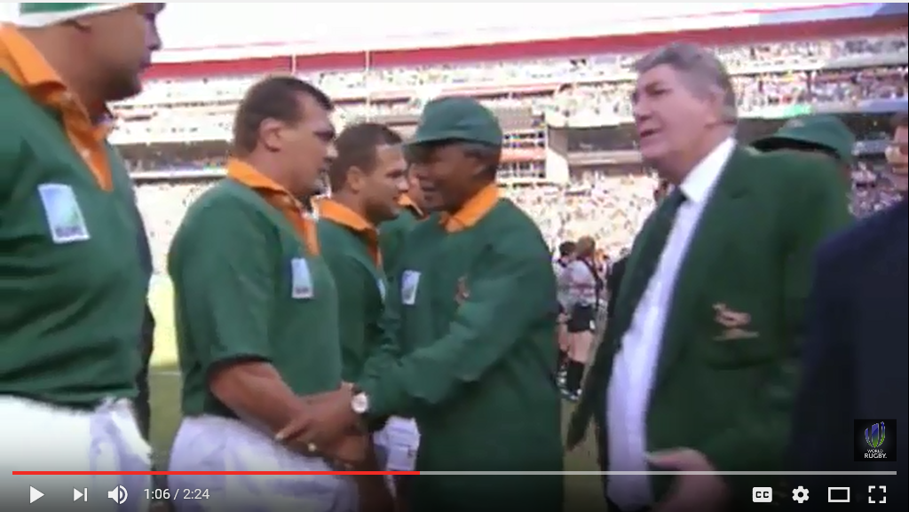
Rugby World cup
Notes:
Although South Africa was instrumental in the creation of the Rugby World Cup competition, the Springboks did not compete in the first two World Cups in 1987 and 1991 because of anti-apartheid sporting boycotts of South Africa. Nelson Mandela was elected president of South Africa in 1994. The next year, the South African rugby team made its World Cup debut in 1995, when the newly democratic South Africa hosted the tournament.
Facing tough criticism from black South Africans, Mandela was determined to bring the two subcultures together. Fearful of civil war, he saw rugby as the mechanism to bring his country together. Mandela met with the Springbok captain, Francois Pienaar, and forged a friendship that proved to be critical. Along with other players and staff members, they helped change the attitude of their country to one of reconciliation and togetherness.
In the picture above, you can see Nelson Mandela wearing the hat and jersey of the Springboks. The jersey itself was the symbol to the black population in South Africa of oppression, privilege, and separation. Mandela purposefully chose to wear the jersey of number 6, Francois Pienaar, the team’s Caucasian captain. Mandela symbolized in this moment being one with his people, but also of being one with those that had oppressed black South Africans for so long.
The Springboks defeated the New Zealand All Blacks 15–12 in the final, which is now remembered as one of the greatest moments in South Africa's sporting history, and a watershed moment in the post-Apartheid nation-building process. The 2009 movie, Invictus, with Matt Damon and Morgan Freeman tells this story in dramatic fashion.

Slide 53
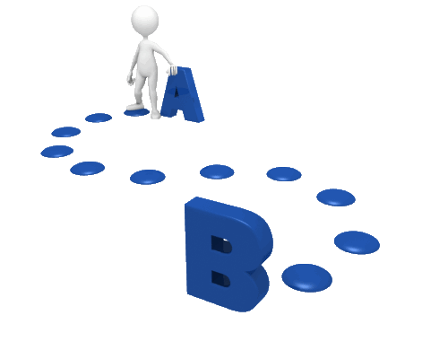
navigating change
Notes:
Nelson Mandela knew that the abolishment of Apartheid in and of itself was not enough to bring about the lasting change South Africa needed. He consolidated improvements and produced more change through the unlikely vehicle of South African rugby.
Currently, we are working within this stage. It’s important to maintain that sense of urgency more so now than ever before, especially after having made those short-term wins. Otherwise, we could run the risk of losing momentum. Now, we are running into “deep change”, and this is where motivating people is key. We can’t afford to skip the hard stuff.
As a leadership team, we are attempting to leverage our short-term wins to make bigger changes with systems and structures. We are working on this stage of the process by building our credibility and identifying those things that require deeper intervention to change. For example, our itinerant teacher of the deafblind has a caseload of 10 students. Not every student in our member district has the opportunity to directly receive services from our itinerant teacher of the deafblind. We recognize that we need an additional teacher of the deafblind, and perhaps even a second Sensory Team. Ensuring consistency when it comes to programming decisions is also a critical issue. Our Sensory Team needs to be involved with initial evaluations and reevaluations for students with deafblindness. We are currently investigating how to make this happen.

Slide 54

8. Institutionalize new approaches
If you do not create your culture, it will create itself.
Notes:
When we enter a new organization, we usually know right away whether or not leadership has established a healthy work culture or not. Culture is a shared set beliefs and values that is expressed through common behaviors and attitudes. Culture is what makes your change efforts truly permanent.
As a leader, you and your team want to be in control of creating and shaping the culture. You do not want to leave this to chance, because, as the picture indicates here, you might not like the end result. That’s why it is critical that you solidify the change you are creating by making it a part of the work culture. But how do you do that?

Slide 55
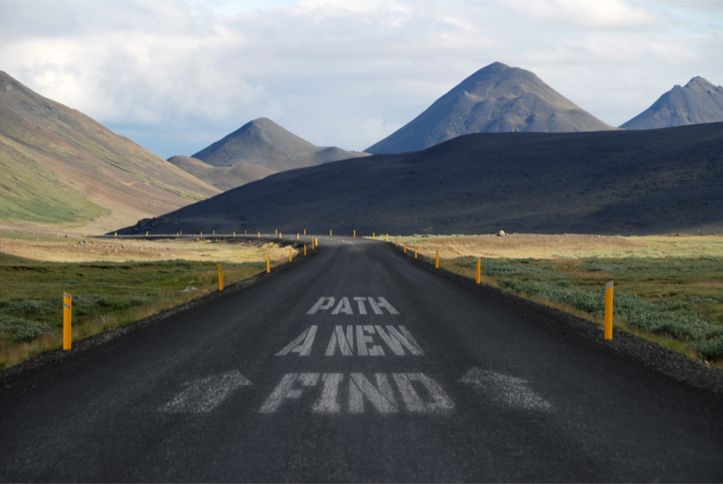
On shaky ground
Notes:
Most recently, I asked our team the following question: If one of you were to leave to find a new path in life, would this team, this approach, continue?” The answer was unanimous – No. They are right too. If our Sensory Team is not accepted by the district leadership as a permanent fixture, it is on very shaky ground should one of us decide to begin a new adventure.

Slide 56

Show improvement
Notes:
Kotter says that at this stage, it is important to really show people how the new approach has led to big improvements. We are becoming more explicit in how we share our success with higher leadership. We want to make sure everyone sees the connections we see.
As I mentioned earlier, every RDSPD has a Management Board, and I meet with our board at least two times a year. I make sure I highlight the work the Sensory Team is doing at each of these meetings. I also look for opportunities to share our story. While webinars are a wonderful platform to share, what I am really referring to is the day-to-day interactions I have within my professional circles. There’s real power in the telling of a vivid story that highlights what the Sensory Team does and why it is succeeding as every telling takes the Sensory Team from “a fad” to “a fixture”.
Additional ways to build change through culture include:
Using new employee orientation for our program as a way to demonstrate that our Sensory Team matters and is invaluable
Promoting Sensory Team members by having them participate in influential and visible events. For example, our itinerant teacher of the deafblind will be presenting at our upcoming statewide deafblind symposium in March.

Slide 57
What Institutionalizing looks like for us
Creating operating guidelines
Establishing interdepartmental procedures
Participating in regional collaboratives
Notes:
There is heavier lifting, though, then the previously mentioned suggestions.
To help make our Sensory Team “business-as-usual” for our program, we have begun working on writing our operating guidelines. As of today, the team has finished the guidelines for evaluations and is currently working on guidelines related to a continuum of placement options, assistive technology, and the determination of instructional and related services.
The team is also working with other departments in the district to help develop and document procedures, such as how the team will be involved in initial and reevaluations.
Finally, the team has joined a larger regional collaborative that focuses on supporting teams for students with deafblindness, connecting with other professionals who have been through the Texas Teacher of the Deafblind Pilot Project. Our Sensory Team has expressed that they have felt even more validated and empowered from participating in this collaborative because they have had the opportunity to meet and network with other local professionals who are walking the same path they are on.

Slide 58

Starting point
Notes:
So here it is – the starting point in your journey for change. My hope is that as you listened to our story today, you found yourself becoming inspired. Perhaps you noted what your concern is, and perhaps you were able to jot down who some members of your core coalition are. Perhaps you were even inspired to begin noting what your why is.
I wish you the best of luck in your journey as you work to transform instruction for your students. If I can be of any help to you along the way, please feel free to reach out to me.

Slide 59
questions
QUESTIONS?

Slide 60
Resources
Division of federal and state education policy. (2013). Regional day school program for the deaf (RDSPD) shared services arrangement (SSA) procedures. Austin, TX: Texas Education Agency.
Kotter International. (2016). John Kotter. Retrieved from http://www.kotterinternational.com/about-us/who-we-are/john-kotter/
Kotter, J.P. (1995). Leading change: Why transformation efforts fail. Harvard Business Review, March–April, 59–67.
National Center on Deaf-Blindness. (2015). The 2014 national child count of children and youth who are deaf-blind. Retrieved from https://91372e5fba0d1fb26b72-13cee80c2bfb23b1a8fcedea15638c1f.ssl.cf1.rackcdn.com/cms/2014_National_Deaf-Blind_Child_Count_Report_v112015_641.pdf
Ryan, S. (2016). How loss aversion and conformity threaten organizational change. Retrieved from https://hbr.org/2016/11/how-loss-aversion-and-conformity-threaten-organizational-change
Sinek, S. (Presenter). (2009, September). How great leaders inspire action. Video retrieved from http://www.ted.com/talks/simon_sinek_how_great_leaders_inspire_action/transcript?language=en#t-245606
YES Prep Public Schools. (2016). Our model. Retrieved from http://www.yesprep.org/our-model .

